Slide 1


Final Year Project Proposal
Edu Path
AI powered Academic and Career Decision Support System
Supervised By: Mr. Nadeem Khan (Lecturer)

Slide 2
Project Team
Farhan Ahmed (56193)
Subhan Ahmed (55572)
Muhammad Zeeshan (56038)

Slide 3
Table of Content
Introduction and Background
Literature Review and Summary Table
Gap Analysis
Problem Statement
Proposed Solution & Methodology
Project Scope
Work Breakdown Structure
Roles and Responsibilities

Slide 4
INTRODUCTION AND BACKGROUND

Slide 5
Introduction and Background
Project Overview
Edu Path is an AI-powered system that gives personalized academic and career recommendations. Using a student’s background, interests, skills, career goals, and preferences, it suggests suitable fields, degree programs, and universities.
Importance of the Problem
Choosing the right academic field, degree program, and university is critical for a student’s future. A wrong choice can cause learning difficulties, wasted time, and financial loss, so personalized guidance is essential.
Current Challenges
Students differ widely in grades, interests, skills, career goals, budgets, and location preferences, yet no single system weighs all these factors together. Searching for fields, programs, and universities separately makes the decision confusing and time-consuming.

Slide 6
LITERATURE REVIEW

Slide 7
Literature Review
No. | Study | Focus | Method | Key Finding | Limitation
1 | Ezz & Elshenawy (2020) | Academic Program Recommendation | Machine Learning | Predicted suitable engineering programs using student academic data. | Mainly focused on academic performance and engineering programs.
2 | Kumar et al. (2022) | Academic Program Recommendation | Fuzzy SVM, Random Forest, C4.5 | Used 21 student attributes to predict suitable academic programs. | Does not include university recommendation.
3 | Rances et al. (2026) | Computing Degree Recommendation | Naïve Bayes, Content-Based Filtering, Cosine Similarity | Used academics, interests, hobbies, career goals, and personality for program recommendation. | Limited to computing programs; no university recommendation.
4 | Kaklauskas et al. (2019) | University & Course Selection | TOPSIS / MCDM | Used multiple criteria to support discipline, course, and university selection. | Does not provide an integrated AI-based personalized recommendation process.
5 | Arcinas et al. (2025) | Course Recommendation | PCA, AdaBoost, KNN, Naïve Bayes | Applied ML techniques to recommend suitable courses. | Focuses on course recommendation rather than field → program → university.

Slide 8
Gap Analysis

Slide 9
Gap Analysis
Existing Research | Identified Gap | Our Project
Academic program recommendation focuses mainly on predicting suitable programs. | Does not provide a complete recommendation from field to university. | Recommends field → program → university.
Some systems use limited student information such as grades or academic performance. | Student interests, skills, career goals, budget, and location may not be considered together. | Uses a complete student profile for personalized recommendations.
Some research focuses only on specific areas, such as engineering or computing. | Limited coverage of different academic fields and programs. | Designed for multiple academic fields and programs.
University selection approaches use MCDM/TOPSIS to rank alternatives. | They do not necessarily connect university ranking with personalized field and program recommendations. | University ranking is performed after program recommendation and based on student-specific criteria.
Existing systems often solve only one part of the academic decision process. | Field selection, program selection, and university selection are treated separately. | Integrates the three decision levels into one system.

Slide 10
PROBLEM STATEMENT

Slide 11
Problem Statement
Students completing intermediate education face difficulty in choosing the right academic field, degree program, and university.
The large number of available fields and programs makes the decision-making process confusing and time-consuming.
Students have different academic backgrounds, grades, interests, skills, career goals, budgets, and location preferences.
Existing guidance approaches often do not consider all these factors together for an individual student.
Students may struggle to determine whether they are eligible for a particular program or university.
Finding universities that offer the desired program while also meeting the student’s eligibility, budget, location, and other requirements requires searching through information from multiple sources.
As a result, students may make academic decisions based on limited information, personal assumptions, or general recommendations rather than their individual requirements.

Slide 12
PROPOSED SOLUTION AND METHODOLOGY

Slide 13
Proposed Solution
Develop an AI-based personalized recommendation system for higher-education decisions.
Collect the students:
  Academic information
  Subjects and grades
  Interests and skills
  Career goals
  Budget
  Preferred location
  Other personal preferences
Use NLP to understand information provided by the student in their own words.
Provide recommendations at three levels:
  Academic Field
  Degree Program
  University
Personalize the recommendations according to the student’s individual requirements.

Slide 14
Methodology
Step 1 Student Profile & Information Collection
The student provides academic, personal, skills, interests, career goals, budget, location, and university preferences through structured, voice, or text-based input.
↓
Step 2 NLP, Speech-to-Text & Adaptive Questioning
The system converts voice responses into text and uses NLP to understand the student’s responses. Based on previous answers, the system dynamically asks relevant follow-up questions to build a more complete profile.
↓
Step 3 Student Profile Generation
The system processes the collected information and generates a structured student profile containing academic performance, skills, interests, career goals, preferences, and other relevant characteristics.
↓
Step 4 Academic Field Recommendation
A Machine Learning model analyzes the structured student profile and recommends the most suitable academic field(s) based on the student’s academic background, skills, interests, and goals.
↓
Step 5 Program Recommendation
Using an LLM with Retrieval-Augmented Generation (RAG), the system matches the recommended academic field with relevant degree programs from the University & Program Knowledge Base.
↓
Step 6 University Filtering
The system filters universities according to program availability, eligibility requirements, budget, location, scholarships, and the student’s individual university preferences.
↓
Step 7 Personalized University Ranking
MCDM/TOPSIS is used to rank the eligible universities according to the student’s individual priorities and assigned criteria weights.
↓
Step 8 Personalized Final Recommendation
The system presents the recommended academic field, suitable degree programs, ranked universities, and a brief explanation of why each recommendation matches the student’s profile and preferences.

Slide 15
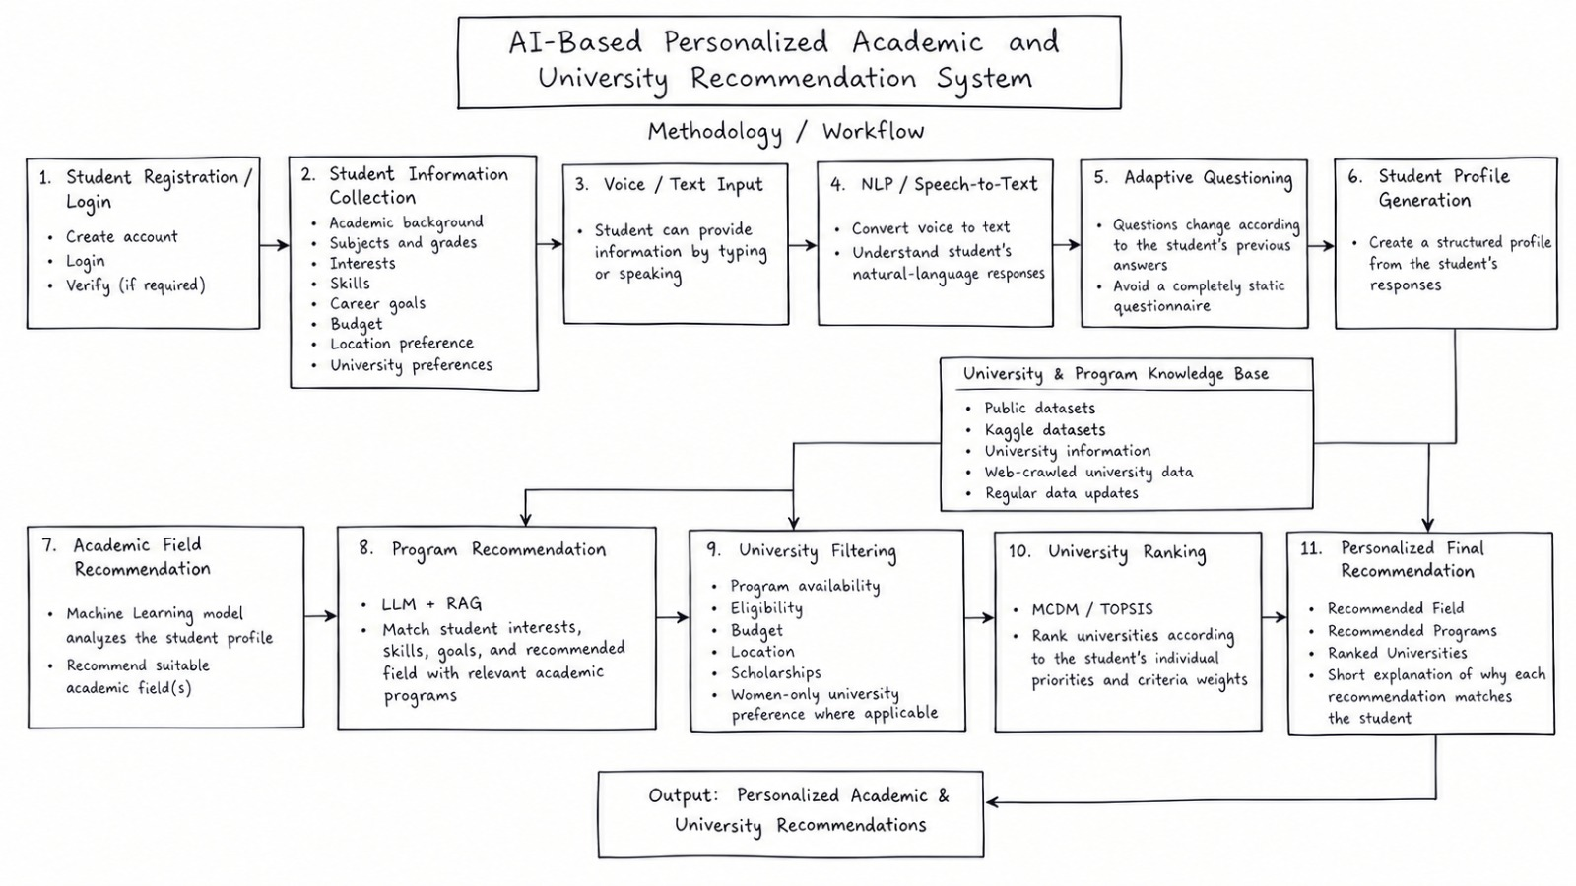
Work-Flow Diagram

Slide 16
PROJECT SCOPE

Slide 17
Project Scope
1. Student Profiling
Collect academic and personal information from students.
Include subjects, grades, interests, skills, career goals, budget, location, and preferences.
Allow students to describe their interests and goals in natural language.
2. Academic Field Recommendation
Analyze the student’s profile.
Recommend the most suitable academic field based on their characteristics.
3. Academic Program Recommendation
Recommend degree programs related to the identified field.
Rank programs according to their compatibility with the student’s profile.

Slide 18
Project Scope (cont’d)
4. University Recommendation
Identify universities offering the recommended programs.
Filter universities according to:
  Admission eligibility
  Program availability
  Location
  Budget
  University type
  Scholarships
  Other student preferences
Rank the remaining universities using MCDM/TOPSIS.
5. Personalized Results
Provide each student with recommendations based on their individual profile and requirements.
Different students can receive different universities even when they receive the same program recommendation.

Slide 19
Major Features (1/2)
9.1 Student Profile
Collects the student’s academic record, personal preferences, interests, career goals, budget, and preferred location.
9.2 Voice + Text NLP
Lets students describe their interests and goals in everyday language instead of picking from fixed options. Students can also provide information by typing or speaking
9.3 Eligibility Checker
Compares the student’s academic profile against program admission requirements to flag eligible and ineligible options.
9.4 Personalized Program Recommendation
Recommends academic programs based on the student’s interests, academic background, career goals, and semantic similarity to program descriptions.
9.5 University Ranking
Ranks eligible universities using academic compatibility, interest match, career compatibility, budget, location, and other factors.

Slide 20
Major Features (2/2)
9.6 University Comparison
Lets students compare universities side by side on fees, eligibility, program fit, location, scholarships, and career alignment.
9.7 Women-Only University Recommendation
The system can recommend women-only universities when the student's gender/preference requires it.
9.8 Skill Gap Analysis
Compares the student’s existing skills with those required for a chosen career and highlights missing skills.
9.9 Adaptive/Dynamic Questions
Answers student questions using a RAG system that retrieves relevant information from verified documents before responding.
Questions will change according to each student's previous answers and profile, instead of asking everyone the same fixed questions.
9.10 Explainable Recommendations
Explains why a particular university or program received a high recommendation score.
9.11 Data Freshness
Tracks the source and last verification date of each piece of university information used in the system.

Slide 21
CONSTRAINTS AND LIMITATIONS

Slide 22
Constraints and Limitations
1. Dataset Dependency
The performance of the machine learning model depends on the quality, size, and relevance of the available training datasets.
Different datasets may contain different attributes and formats.
2. Web Crawling Limitations
University websites may have different structures and formats, making data extraction challenging.
Some websites may use dynamic content, PDFs, or restricted pages that can affect data extraction.
3. Data Freshness
The system will crawl university websites on a weekly basis to update information.
However, changes made between crawling cycles may not be reflected immediately.
4. LLM Limitations
The LLM may sometimes misinterpret natural-language information provided by students.
Program recommendations may depend on the quality and completeness of the available program descriptions.
5. Machine Learning Limitations
Field recommendation depends on the patterns learned from the training data.
The model may be less reliable when dealing with unusual or previously unseen student profiles.
6. MCDM/TOPSIS Limitations
University rankings depend on the weights assigned to different criteria.
Changes in a student’s preferences or priorities can result in different university rankings.
7. Recommendation Limitation
The system provides personalized decision support, but it cannot guarantee admission or that a recommendation will be the perfect choice for every student.

Slide 23
THANK YOU
ANY QUESTIONS?

